Slide 1

NBA PLAYER STATISTICAL ANALYSIS AND PREDICTION PROJECT
COLLABORATORS
JACOB EVANS
KARAN ANAND
MERT OZTOP
PRATIK PUROHIT
PRIYA MARINGANTI

Slide 2

OVERVIEW
This project aims to develop a basketball player statistics analysis and prediction system using machine learning techniques with NBA player datasets. The system utilizes historical player data to provide insights into player performance and predict player stats for the upcoming season, by leveraging the power of machine learning algorithms and the comprehensive NBA player statistics dataset.
Objectives
Predict basketball player stats for the upcoming season based on historical data
Leverage player stats from the previous year to forecast player performance
Identify suitable machine learning algorithms for scalability, accuracy, and interpretability in predicting player performance
Evaluate the performance of the prediction system and ensure its effectiveness in real-world scenarios, such as team selection and player scouting

Slide 3

METHODOLOGY
Methodology
Data Collection: Gather a large dataset of NBA player statistics from the Kaggle dataset
Data Preprocessing: Clean, normalize, encode, and engineer features from the NBA dataset
Exploratory Data Analysis: Gain insights, patterns, and analyze feature distributions
Model Training and Evaluation: Experiment with various machine learning algorithms, fine-tune models for accurate predictions
User Interface Development: Create an intuitive interface for users to input player data and view predictions
Testing and Validation: Ensure the accuracy, robustness, and scalability of the prediction system

Slide 4
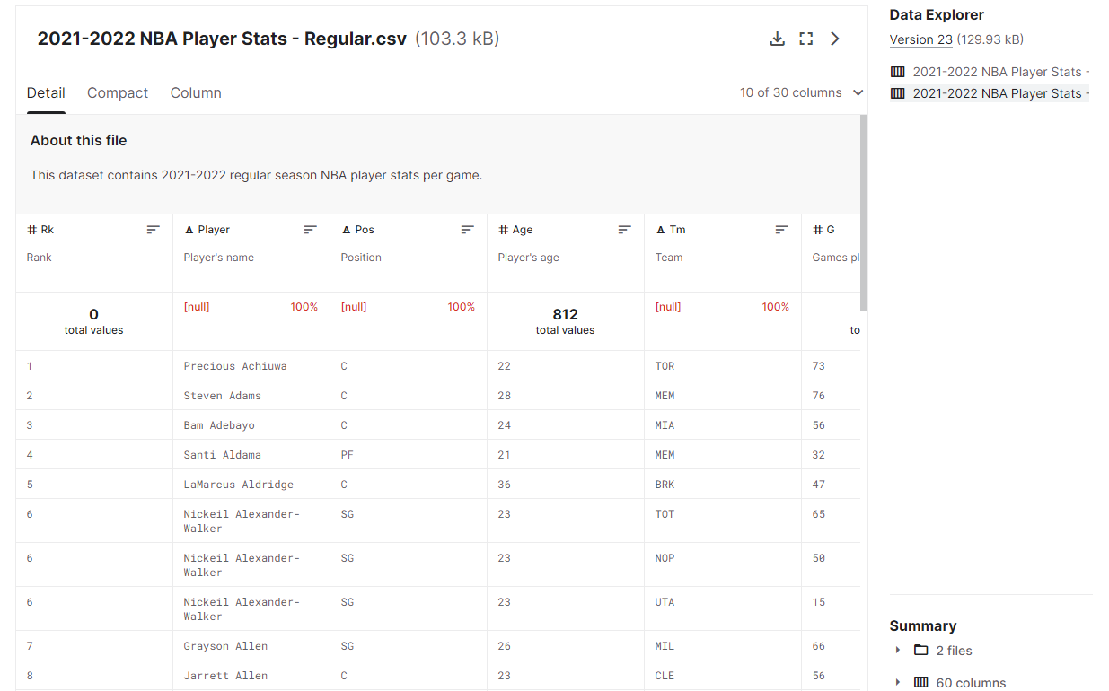
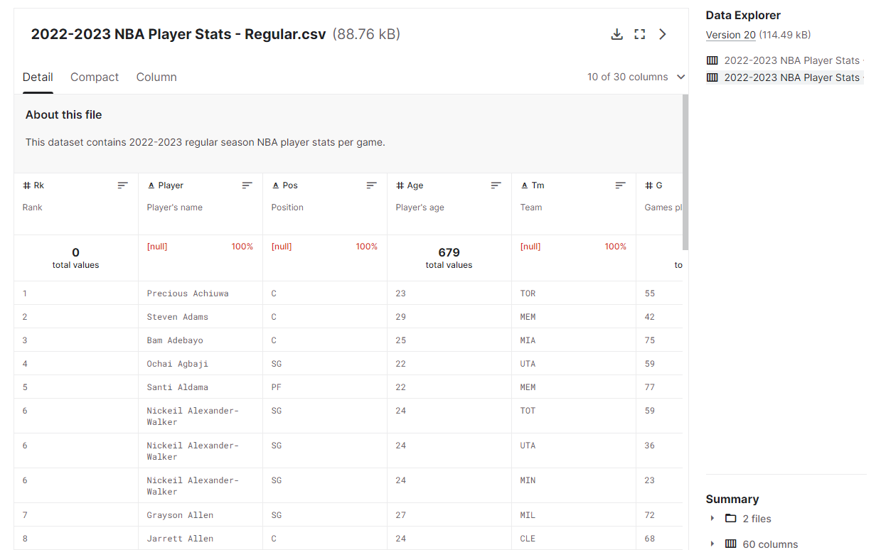
DATA SOURCE - KAGGLE
Retrieving last two seasons’ data from Kaggle

Slide 5
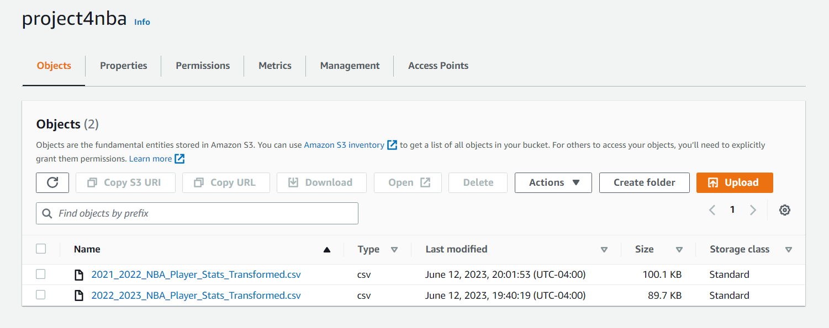
DATA ON s3 AWS
Data on s3 AWS
Uploading the data sets on AWS for the main code

Slide 6
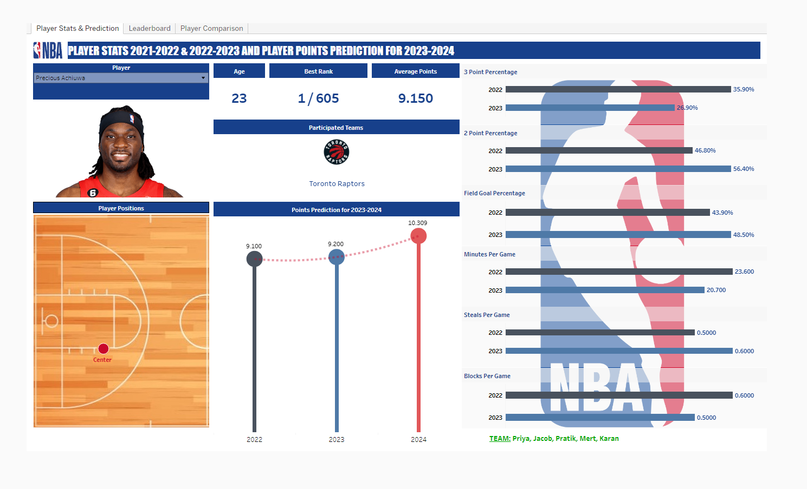
DASHBOARD 1

Slide 7
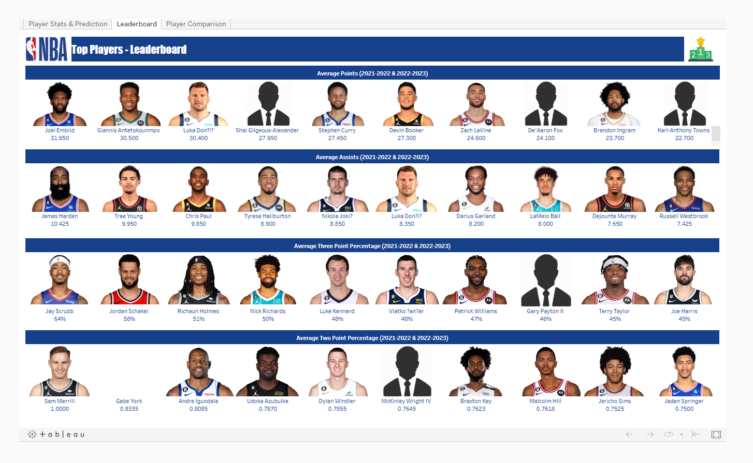
DASHBOARD 2

Slide 8
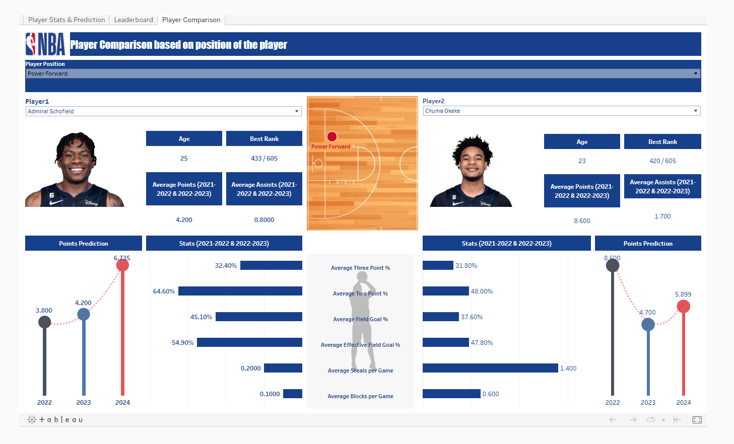
DASHBOARD 3

Slide 9
CHALLENGES
Bad Encoding: The original data had encoding issues that we struggled to handle. We had to apply encoding techniques to ensure proper handling and interpretation of the data.
External Factors: While player statistics provide valuable insights, it's important to note that other factors can influence a player's performance on the court. Factors such as injuries, team dynamics, coaching strategies, and external circumstances were not included in our analysis. Considering these external factors could further enhance the accuracy and predictive power of the model.
Outliers: To handle these outliers, we implemented a post-processing step where we replaced any negative predicted values with zeros. This approach allowed us to address the outliers and ensure that the predicted statistics remain within a valid range. By zeroing out the negative values, we mitigated the impact of outliers on the model's performance and ensured that the predicted player statistics align with the expectations of NBA player performance.

Slide 10
RESULT
The prediction system achieved R-squared value of 0.9998, indicating a high level of accuracy in predicting player statistics based on the historical data.
The NBA Player Statistics Analysis and Prediction System leverages historical player data, applies machine learning techniques, and provides valuable insights and predictions on player performance. The system can assist with team selection, player scouting, and forecasting player statistics for the upcoming season.

Slide 11

THANK YOU
QUESTIONS ARE WELCOME

